Slide 1

FINAL REVIEW
STRESS DETECTION USING MACHINE LEARNING
MENTOR :
Mrs. Soundari D.V
Assistant Professor
TEAM MEMBERS :
Jithish M (20EUEC068)
Kamalesh A (20EUEC070)
Karan P (20EUEC071)

Slide 2
INTRODUCTION :
Stress is a common part of everyday life that most people have to deal with on various occasions.
Stress symptoms can affect your body, your thoughts and feelings, and your behavior. Knowing common stress symptoms can help you manage them. Stress that can’t deal with can lead to many health problems, such as high blood pressure, heart disease, stroke, obesity and diabetes.
However, having long-term stress, or a high degree of stress, will hinder our safety and disrupt our normal lives.

Slide 3
OBJECTIVE :
In this project we predict the mental stress level by facial recognition and physiological data.
Stress level can be calculated with the help of machine learning.
Our main objective is to predict the stress level of human by increasing accuracy with 97% using machine learning.

Slide 4
LITERATURE SURVEY :
Title | Authors | Methodology | Year
Facial Emotion Detection Using Deep Learning | Akriti Jaiswal | (CNN) based deep learning architecture for emotion detection from images | 2019
Analysis of Facial Emotion Recognition | Balaji Balasubramanian | Algorithms that are used for Facial Emotion Recognition (FER). The algorithms range from simple Support Vector Machines (SVM) to complex Convolutional Neural Network (CNN). | 2020
Emotion Recognition Using Deep Convolutional Neural Network | E. Pranav | Emotion Recognition Using Deep Convolutional Neural Network | 2018

Slide 5
Mental stress detection using machine learning algorithm | Aishwarya Bannore, Tejashree Gore, Apoorva Raut, Kiran Talele | Facial expression recognition using Convolutional Neural Network (CNN) and Local Binary Pattern (LBP), experimented with Indian and Cohn-Kanade databases | 2018
Stress Detection with Machine Learning and Deep Learning using Multimodal Physiological Data | Pramod Bobade, M. Vani | Machine learning and deep learning techniques using multimodal dataset recorded from wearable physiological and motion sensors | 2019

Slide 6
PROPOSED SYSTEM :
The project's methodology uses a two-pronged methodology: first, camera is used for real-time facial expression analysis to determine emotional reactions.
The DenseNet 121 architecture is chosen for its ability to capture intricate features efficiently.the model is initialized with pre-trained weights on a large scale dataset, facilitating the transfer of knowledge from general image recognition tasks.
Simultaneously, the MAX30100, DHT-11, and Pressure sensor is utilised to record physiological variables including blood pressure and temperature.By Combining the data from physiological sensors and facial expressions further improves the precision and accuracy of stress evaluation through the use of machine learning algorithms.

Slide 7
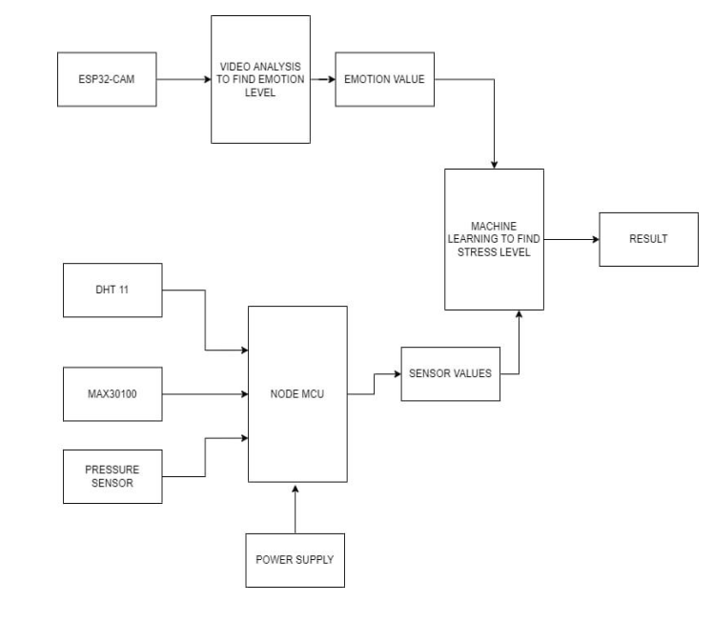
BLOCK DIAGRAM

Slide 8
WORKING :
FACIAL EXPRESSION ANALYSIS WITH CNN :
Preprocess the collected facial expression dataset, including image normalization and augmentation techniques to enhance model robustness. Train a Convolutional Neural Network (CNN) using frameworks like TensorFlow or PyTorch, leveraging architectures suitable for facial expression recognition.
Implement real-time facial expression analysis using a webcam to capture and process live video frames.
The CNN predicts stress levels based on the recognized facial expressions, providing a dynamic assessment in real-time.

Slide 9
PHYSIOLOGICAL MONITORING WITH SENSORS AND KNN:
Set up the MAX30100, DHT - 11, and Pressure sensor to capture physiological parameters, ensuring proper calibration and data acquisition.
Designed a K-Nearest Neighbors (KNN) algorithm to process the sensor data, considering factors such as temperature and blood pressure patterns associated with stress.
Implement real-time data streaming from the sensors, feeding the processed information into the KNN algorithm for continuous stress level prediction.

Slide 10
RESULTS :
The development of a stress detection system that combines physiological parameters with facial expression analysis in real time is one of the project's expected goals.
The technology utilises a MAX30100 sensor and computer vision algorithms to deliver real-time input on an individual's stress level.
By Combining the data from physiological sensors and facial expressions further improves the precision and accuracy of stress evaluation through the use of machine learning algorithms.
Further our project will help to give remedies for the people with higher stress levels based on the evaluation of the data.

Slide 11
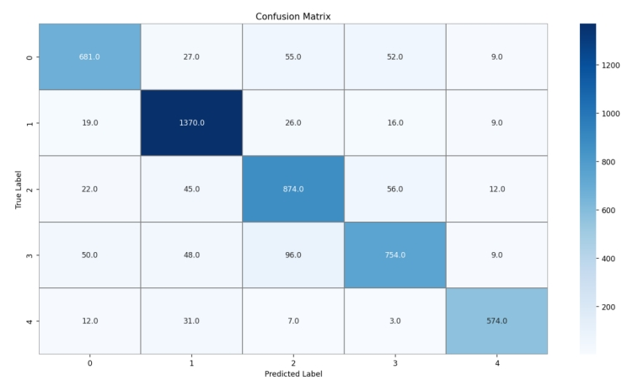
CONFUSION MATRIX OF CNN
The confusion matrix is used to describe the performance of a classification model.
It displays the counts of true positive, true negative, false positive, and false negative predictions for each class.
Each row represents the actual class, while each column represents the predicted class.

Slide 12
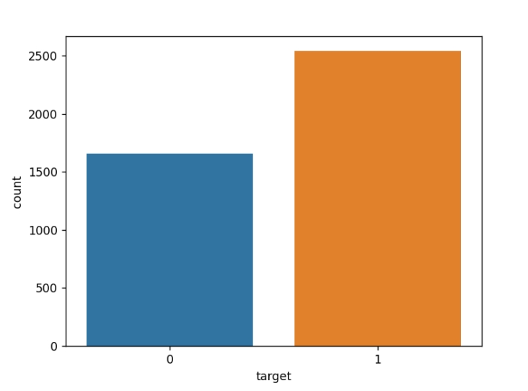
BAR GRAPH OF KNN
The Bar Graph of KNN shows the distribution of classes in the datasets using a bar plot.
Each bar represents the count of instances belonging to a specific class (target).
This visualization helps to understand the class distribution and balance within the datasets.

Slide 13
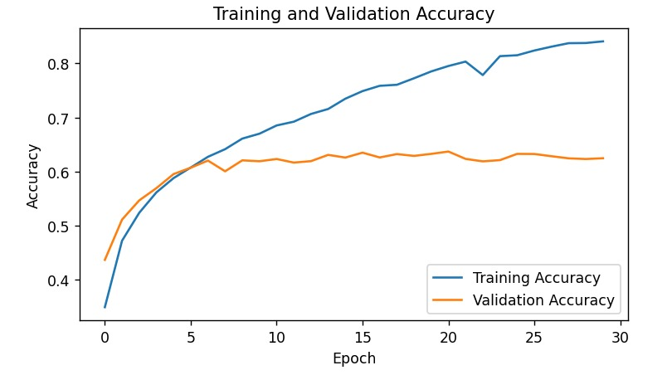
TRAINING AND VALIDATION ACCURACY
The Training and validation accuracy shows how the accuracy of the model changes over training epochs.
The training accuracy curve represents the accuracy of the model on the training data, while the validation accuracy curve represents the accuracy on a separate validation set.
If both curves increase and converge, it indicates that the model is learning well without over fitting.

Slide 14
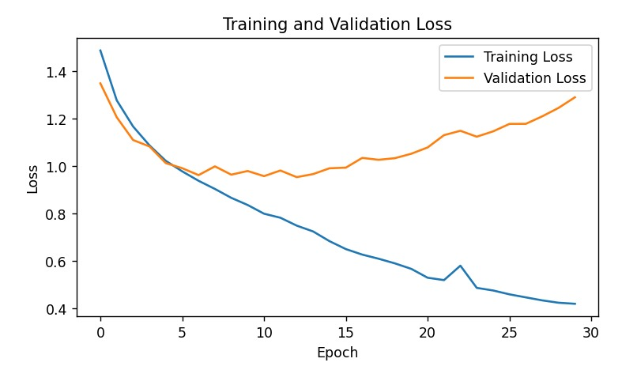
TRAINING AND VALIDATION LOSS
The Training and Validation loss shows the changes in the loss function (sparse categorical cross-entropy) over training epochs.
Lower values indicate better performance.
The training loss curve should decrease over epochs, while the validation loss curve should initially decrease but then stabilize or increase if over fitting occurs.

Slide 15
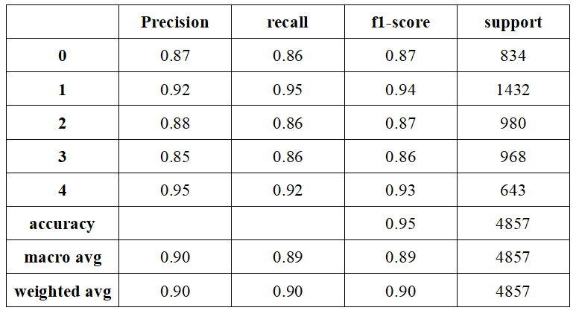
CLASSIFICATION REPORT OF CNN

Slide 16
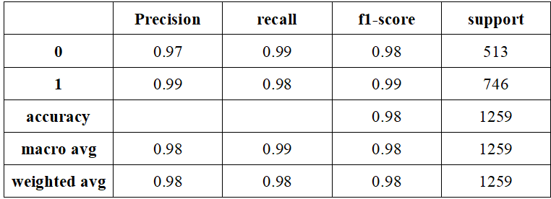
CLASSIFCATION REPORT OF KNN

Slide 17
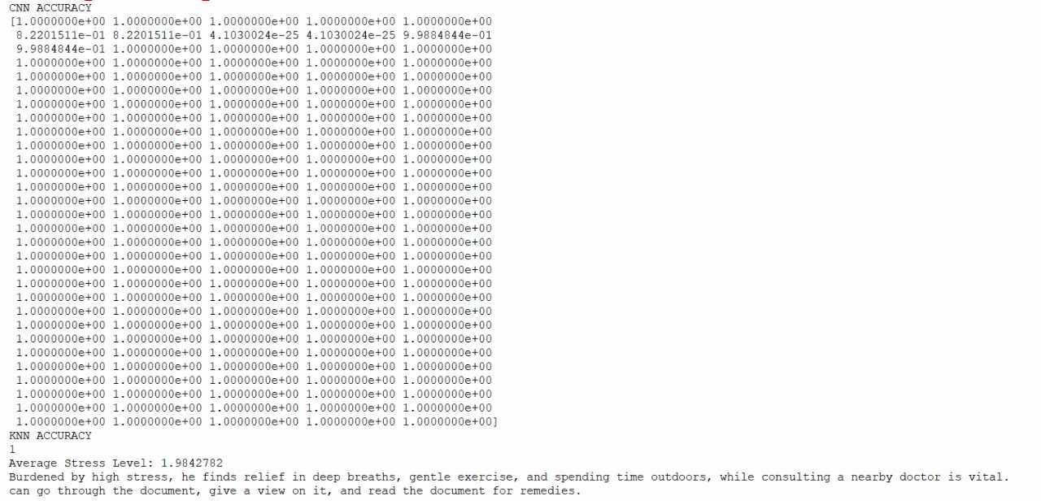
OUTPUT OF STRESS DETECTION

Slide 18
References :
1. Akriti Jaiswal, A. Krishnama Raju, Suman Deb, "Facial Emotion Detection Using Deep Learning",2020 International Conference for Emerging Technology (INCET)
2. Akshita Sharma, Vriddhi Bajaj, Jatin Arora, "Machine Learning Techniques for Real-Time Emotion Detection from Facial Expressions",2023 2nd Edition of IEEE Delhi Section Flagship Conference (DELCON)
3. Balaji Balasubramanian, Pranshu Diwan, Rajeshwar Nadar, Anuradha Bhatia,” Analysis of Facial Emotion Recognition",2019 3rd International Conference on Trends in Electronics and Informatics (ICOEI)
4. Charvi Jain, Kshitij Sawant, Mohammed Rehman, Rajesh Kumar," Emotion Detection and Characterization using Facial Features",2018 3rd International Conference and Workshops on Recent Advances and Innovations in Engineering (ICRAIE)
5. Dahmane, M., Alam, J., St-Charles, P. -L., Lalonde, M., Heffner, K., & Foucher, S. (2022). "A Multimodal Non-Intrusive Stress Monitoring From the Pleasure-Arousal Emotional Dimensions," IEEE Transactions on Affective Computing

Slide 19
THANK YOU

